Slide 1
NBA Player Analytics - Week 2 Deliverables
Team - D&A champs
Aug 8th, 2021

Slide 2
Why NBA Topic was selected:
NBA is one of the favorite sporting event in the US. The viewer rating for NBA shows that this event is one of the biggest sports and entertainment in US. The idea is to make this project more enticing and favorable for the audience.
Source Data:
Used Kaggle to download the following datasets related to NBA:
NBA Player Stats from 2016 to 2020
NBA Player Salaries from 2016 to 2020
NBA Player Salary Cap
Insights from the Data:
There is a new club that wants to build a team and they want to sign up contract with different players. They have a budget of 110 million USD. They want to build a well-balanced team choosing players of different tiers. They want to see players of different tiers so that they can sign up with them
2. A relatively new players want to predict Whether his salary is going to increase, decrease or remains similar in next
subsequent seasons based on his performance statistics in NBA.

Slide 3
Data Discovery and Analysis:
Xxxxxxxxxxxx
xxxxxxxxxxxx
Data Visualization:
Used Tableau as a visualization tool
As a selector, by selecting the Tier and Position from the dashboard, the selector gains the following insights about the players,
Top players for each of the stats (eg: 3P, ASST, BLK..)
The average score of each player across all the seasons for each of the stat
How players performed in each of the season for the selected stat
Players salary across each seasons
Players total points across each season
The dashboard has various screens to display the afore mentioned features

Slide 4
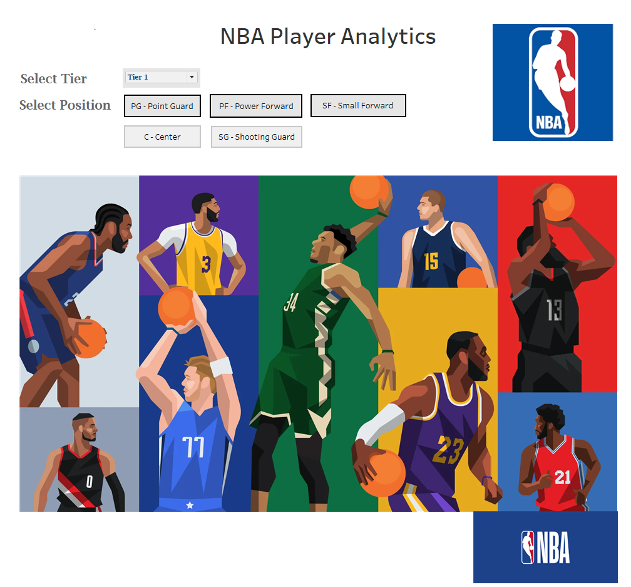
Dashboard Landing Page - Mockup
Selector selects the tier and the position

Slide 5
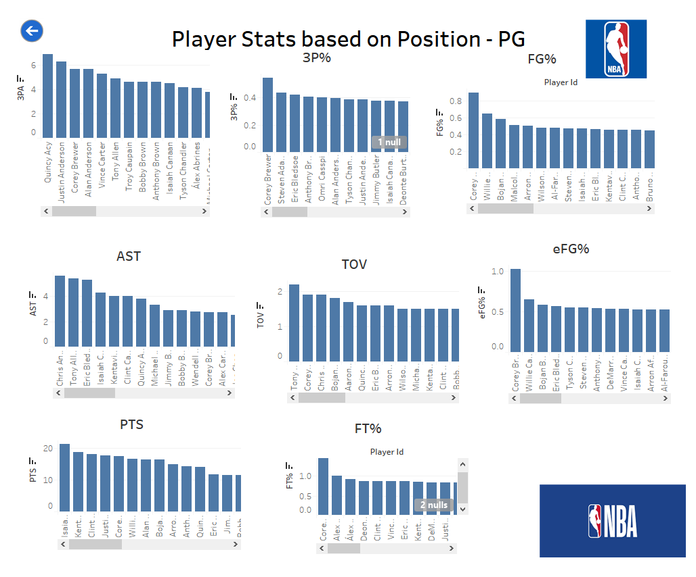
Player Stats Page - Mockup
Back button to go back to previous screen
Each player can be clicked to get further insights about the player, Control navigates to next screen

Slide 6
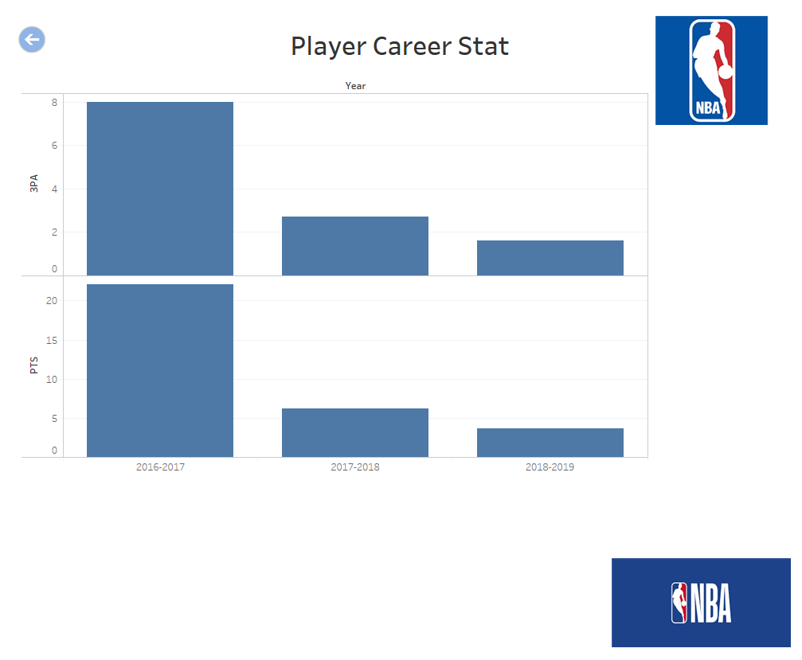
Player Career Stats Page - Mockup
Back button to go back to previous screen

